Slide 1

Innovating Early Diagnosis with IDDS
Every day, thousands delay or miss early diagnosis.
Reasons: rural location, doctor shortage, symptom confusion.
Early detection saves lives; technology can bridge gaps.

Slide 2
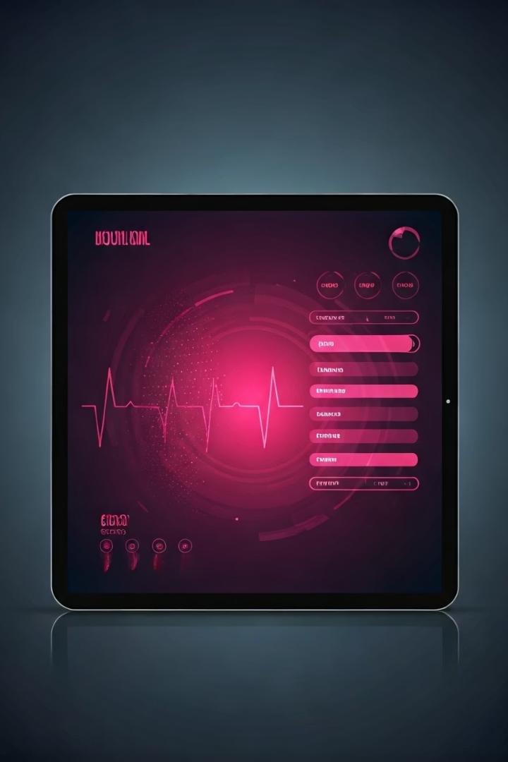
A Smarter Way to Begin Diagnosis
IDDS Overview
Key Features
Intelligent Disease Diagnosis System empowering users and practitioners.
Symptom input
Machine Learning predictions
Four model comparisons
Simple GUI
Purpose
Assist, not replace doctors; improve early detection.

Slide 3
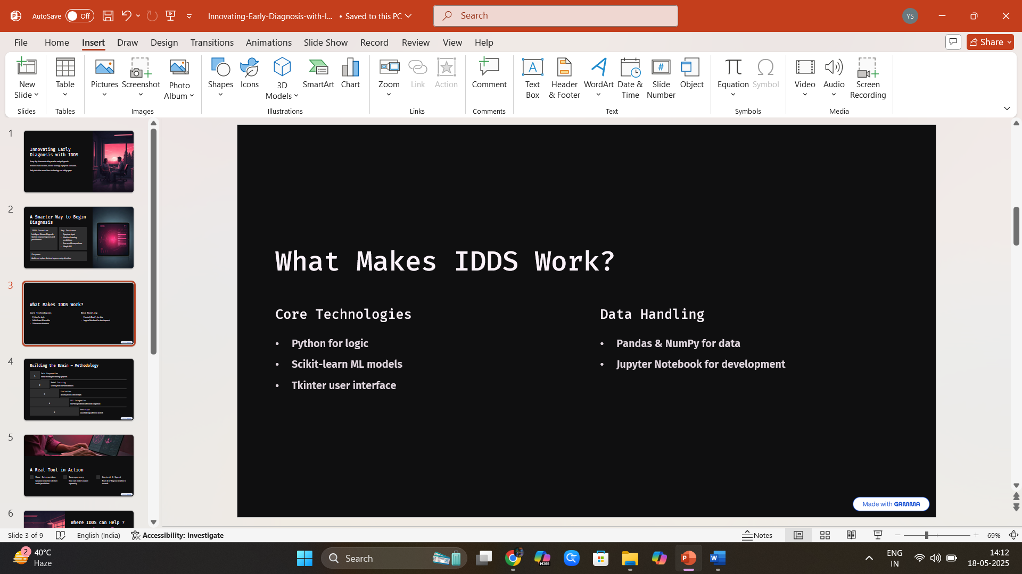
What Makes IDDS Work?
Core Technologies
Data Handling
Python for logic
Pandas & NumPy for data
Scikit-learn ML models
Jupyter Notebook for development
Tkinter user interface

Slide 4
Building the Brain – Methodology
Data Preparation
1
Binary encoding and labeling symptoms
Model Training
2
Learning from real-world datasets
Evaluation
3
Accuracy checks & bias analysis
GUI Integration
4
Real-time predictions with model comparison
Prototype
5
Launchable app with reset and exit

Slide 5
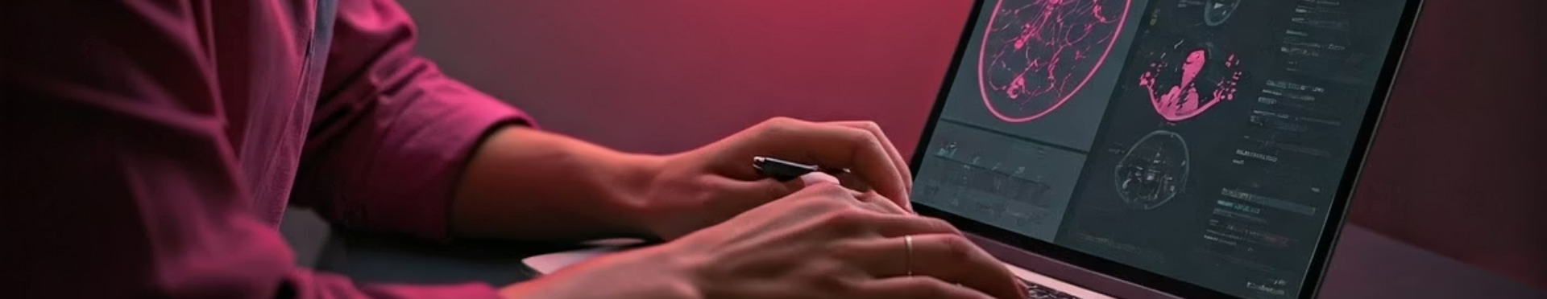
A Real Tool in Action
User Interaction
Transparency
Control & Speed
Symptom selection & instant model predictions
View each model's output separately
Reset & re-diagnose anytime in seconds

Slide 6





Where IDDS can Help ?
Rural Clinics
Telemedicine
Education
Supporting limited healthcare resources
Empowering remote consultations
Training future health workers & students
Self-assessment
Informed decisions before doctor visits

Slide 7






Beyond Today – What's Next
Voice Input
Simplify symptom entry for all users
Mobile App
On-the-go diagnosis access
Sensor Integration
Vital signs enhance accuracy
Expanded Dataset
Support for more diseases
Multilingual Support
Reach global audiences
Deep Learning Hybrids
Boost prediction precision

Slide 8





Why IDDS Stands Out
Transparency
User Friendly
Shows model workings, not a black box
Doctor Support
Balances ease and technical depth
Complements, doesn’t replace medicine
Rooted in Reality
Scalable
Based on real data and problems
3
Built for growth and responsibility
2
4
1
5
Bridging people to better health decisions responsibly.

Slide 9

Thank You for Exploring IDDS
Y

